Slide 1


AEGIS HUMS Platform
Mission Readiness & Predictive Maintenance Copilot
TEAM DREAMERS

Slide 2

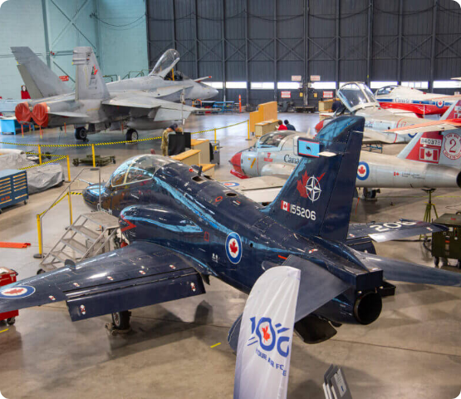
The Readiness Problem
Critical Now: Military organizations cannot reliably determine whether aircraft, vehicles, and equipment are mission-ready.
Fixed Schedules: Maintenance runs on fixed calendar schedules regardless of actual component condition.
Wasted Data: HUMS (Health & Usage Monitoring System) sensor data that could predict failures weeks in advance sits unanalysed.
Massive Cost: When platforms fail unexpectedly, operational readiness drops and recovery takes weeks. The US military spends $90B/year on maintenance — shifting to predictive approaches saves billions.
Your Challenge: Build a Bob Copilot that ingests sensor data and service records to identify non-ready assets, explain each readiness issue, predict which components will fail before the next mission window, and recommend a prioritized maintenance plan.

Slide 3
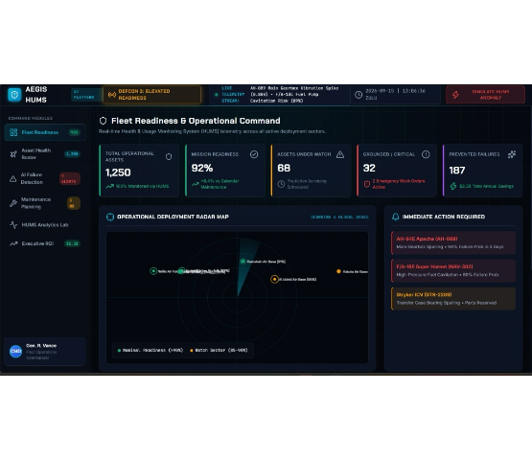
Our Solution: Bob Copilot
AEGIS HUMS Platform: A centralized AI-powered Fleet Readiness system.
Meet Bob Copilot: Automates telemetry ingestion and surfaces critical insights.
Total Visibility: Provides commanders with real-time views of mission readiness across all operational sectors.
Predictive Action: Identifies non-ready assets immediately and explains exact readiness issues dynamically.

Slide 4
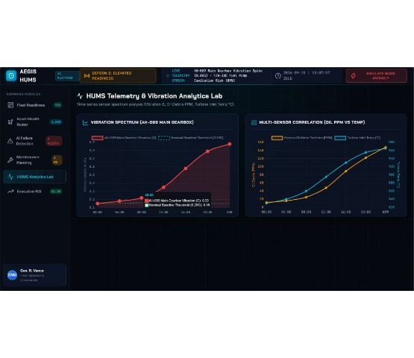
Technical Architecture
1. Telemetry Ingestion: Continuous, real-time streams of vibration, oil debris, and temperature data from active field assets.
2. Stream Processing: High-throughput event routing via IBM Event Streams into scalable Cloud Object Storage.
3. AI Inference: Machine learning models continuously score Remaining Useful Life (RUL) and forecast failure horizons.
4. Command Interface: React-based UI surfaces actionable intelligence and seamlessly integrates with enterprise asset management.

Slide 5
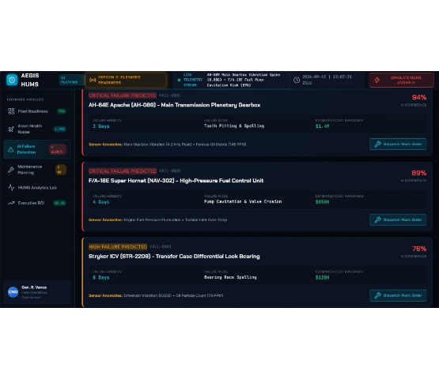
Key Feature: Failure Detection
Pinpoint Accuracy: Shifts maintenance from reactive to predictive by detecting exact component breakdown risks.
Sensor Anomalies: Analyzes complex signatures (e.g., high-frequency vibration peaks & ferrous debris).
AI Confidence: Delivers failure horizons with up to 94% certainty.
Impact Tracking: Automatically calculates estimated cost avoidance per incident to justify actions.

Slide 6
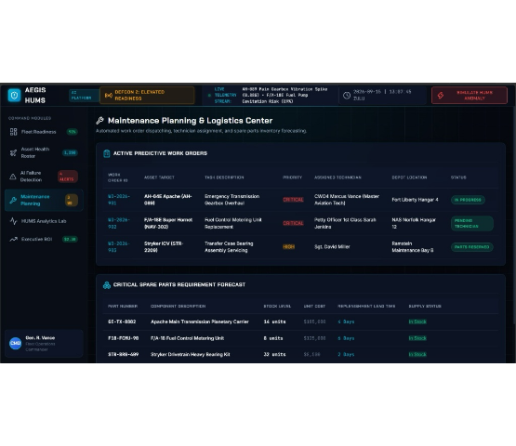
Powered by IBM Technologies
watsonx.ai: Powers the core predictive maintenance ML models. Ingests historical failures to forecast Remaining Useful Life (RUL).
IBM Maximo: Integrates seamlessly to automate repair work orders, assign technicians, and manage spare parts inventory.
watsonx Assistant: Drives the "Bob Copilot" conversational interface, allowing fleet commanders to query readiness naturally.
IBM Cloud: Provides the scalable, secure infrastructure and Cloud Object Storage needed to handle continuous global telemetry.

Slide 7
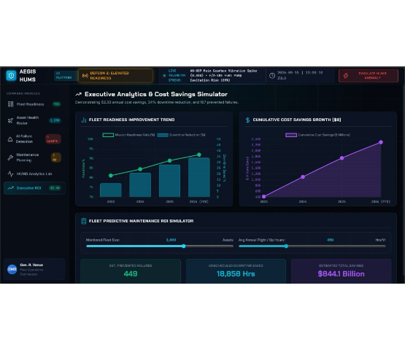
Results & Impact
92% Mission Readiness: Achieved an +8.4% operational improvement compared to traditional calendar-based maintenance schedules.
187 Failures Prevented: Intercepted critical breakdowns before grounding assets across 1,250 continuously monitored vehicles.
$2.3B Annual Savings: Massive cost avoidance derived from 18,858 hours of unscheduled downtime saved globally.

Slide 8
THANK YOU!

